Slide 1
Convolutional NN
Mukund - JnanaAdvisory

Slide 2
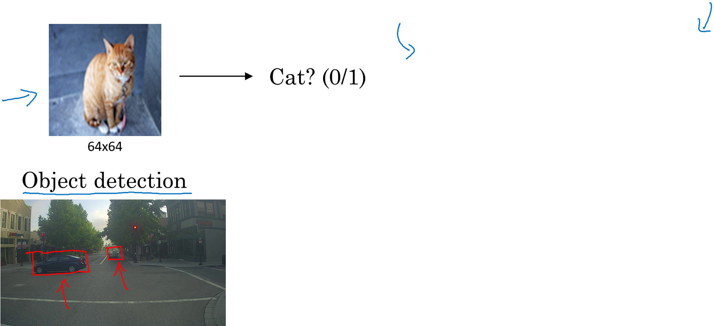
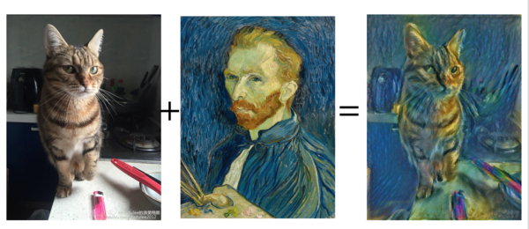
Various Application of Convolutional Neural Networks
Image Classification
Neural Style Transfer

Slide 3
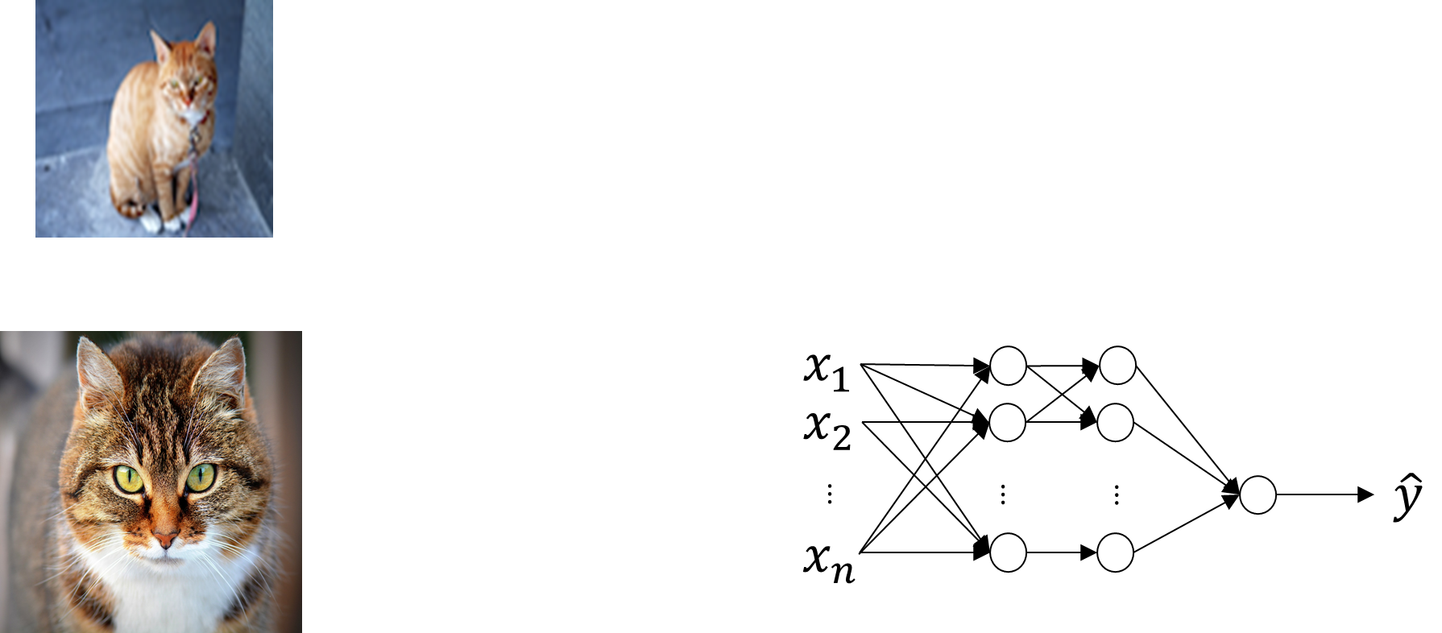
What does it take to recognize an image accurately
Low resolution cat image = 64 X 64 X 3 = 12288 parameters to process
3 layer NN processing cat image
3 million
1000 filters
3 billion parameters
HUGE
High Res cat image = 1000 X 1000 X 3 = 3 million parameter to process
Solution – We Convolve

Slide 4
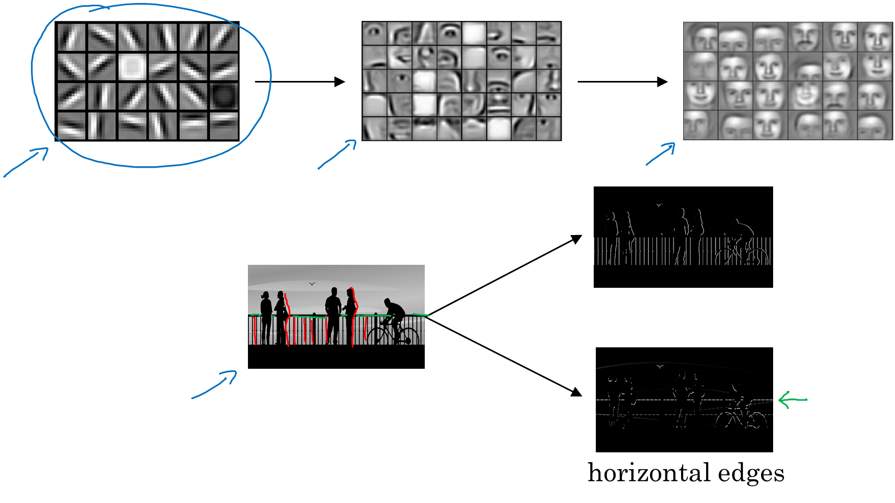
Feature extraction in image recognition
Vertical edges
Image recognition in Computer vision problem consists of edge detection and then putting the edges together to reconstruct problem.
Two types of edge detections are vertical and horizontal edge detection

Slide 5
What is Convolution
Filtering technique to detect edges

Slide 6
Filters are Always treated as parameters to be learnt in CNN

Slide 7
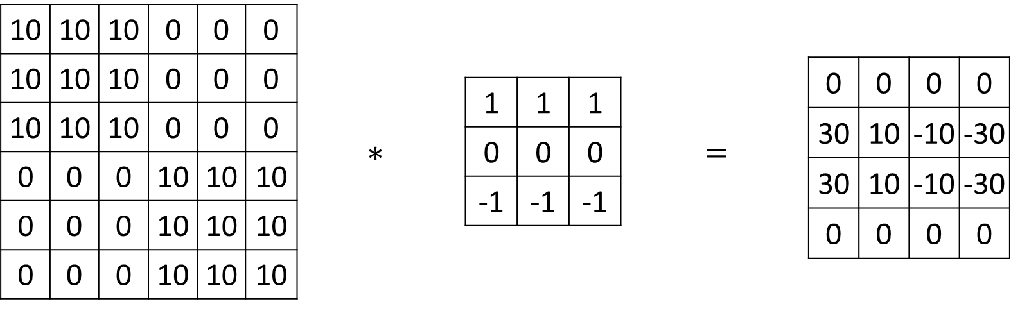
Horizontal Edge detection

Slide 8
Problems with Convolution
Filters make edges less and less prominent. Edge information gets discarded as we go deeper into NN.
6X6 image --- > Filter ( 3X3) -- > 4X4 OUTPUT IMAGE.
Solution --- Padding – pad the borders with zeros.
Two types of Padding are prevalent
Valid Padding – There is no padding, P = 0 (Padding is Hyperparameter, we will talk about that later)
Zero padding – Pad size is determined by subsequent filter size. P = (Filter size – 1)/2; if filter size is 3X3, P = 1; Advantage is Input size = Output size; for 6X6 image, with a 3X3 filter, and a padding of 1, after convolution, output image is again 6X6

Slide 9
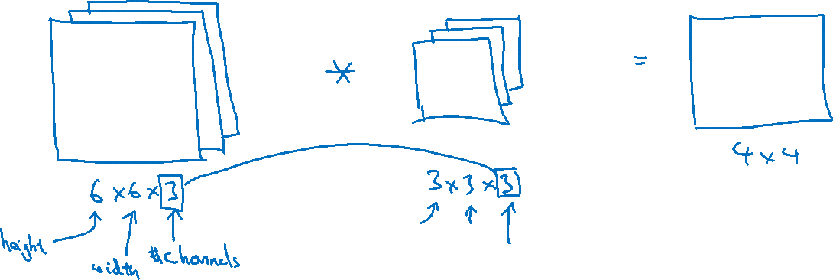
Convolutions on RGB images with strides( pace of filtering)
Convolution over Coloured image – use additional parameter
RGB – 3 in both image channels and filter.

Slide 10


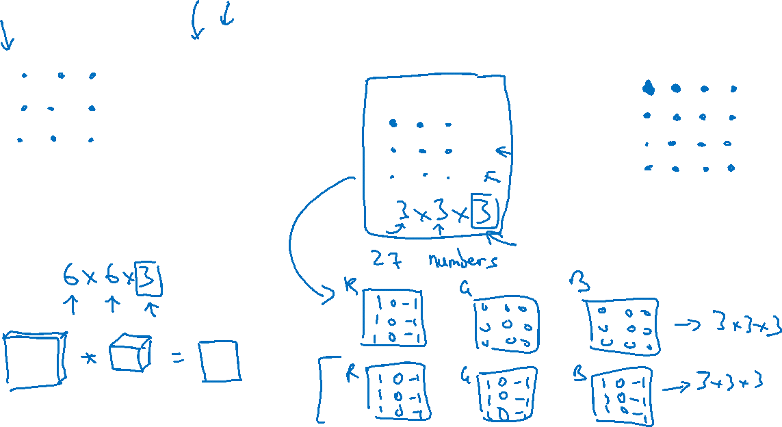
Convolutions on RGB image
$$∗$$
$$=$$
4 x 4

Slide 11





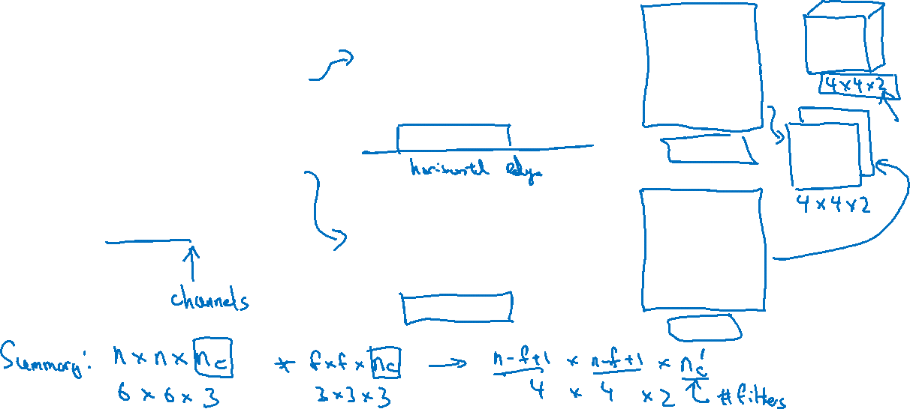
Multiple filters
$$∗$$
$$=$$
3 x 3 x 3
4 x 4
6 x 6 x 3
$$∗$$
$$=$$
3 x 3 x 3
4 x 4

Slide 12
A convolution NN example
Above network is used for handwriting recognition
What is pooling
Another method is average pooling

Slide 13
Enough talk let us build
Code walk thru
http://localhost:8888/notebooks/Mukund%20zekelabs%20build%20CNN%20tf.ipynb

